Slide 1
NSS @ IITR
Achievements

Slide 2
What is NSS?
NSS – National Service Scheme
Established in 1969 on the recommendation of the first Education Commisssion (1950) at the initiative of Pt. Jawaharlal Nehru
Started with an outlay of Rs. 5 crores under the 4th Five Year Plan.
Spread throughout the country in universities and colleges.

Slide 3
Aims of NSS
To work with/among people
To engage in creative and constructive social action.
To enhance the knowledge of oneself and the community.
To put academic knowledge to practical use in mitigating some of the problems of society
To obtain experience in the exercise of democratic leadership.
To gain skills in programme development that enable one to be self-employed.
To bridge the gulf between the educated and the uneducated masses.
To promote the will to serve the weaker section of the community.

Slide 4
NSS @ IITR – History
Was part of University of Roorkee
Became dormant during the transition to IITR
Was restarted under the guidance of the Dean of Students Welfare in 2002-2003.

Slide 5
Organizational Structure
Professors
Dr. V. K. Katiyar - Program Coordinator
Dr Praveen Kulshreshta - Program Officer
Executive Team
Sourabh – General Secretary
Cells
Prerna, Disha, R&D, Health & Environment, Human Welfare, Social Awareness
Rakesh G – Joint Secretary

Slide 6
Health and Environment Cell
Sainath Chowdhary

Slide 7
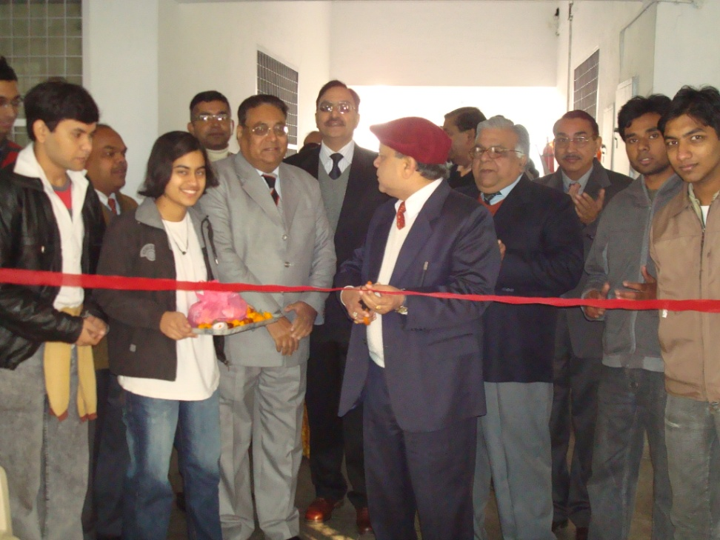
Health and Environment Cell Activities this year
Environmental Awareness Quiz
Regular Yoga Camps (2 months)
Shram Daan – Planting of trees at the IITR Hospital
Blood Donation Camp – 293 units of blood
Eyesight reduction program in association with the R&D cell

Slide 8
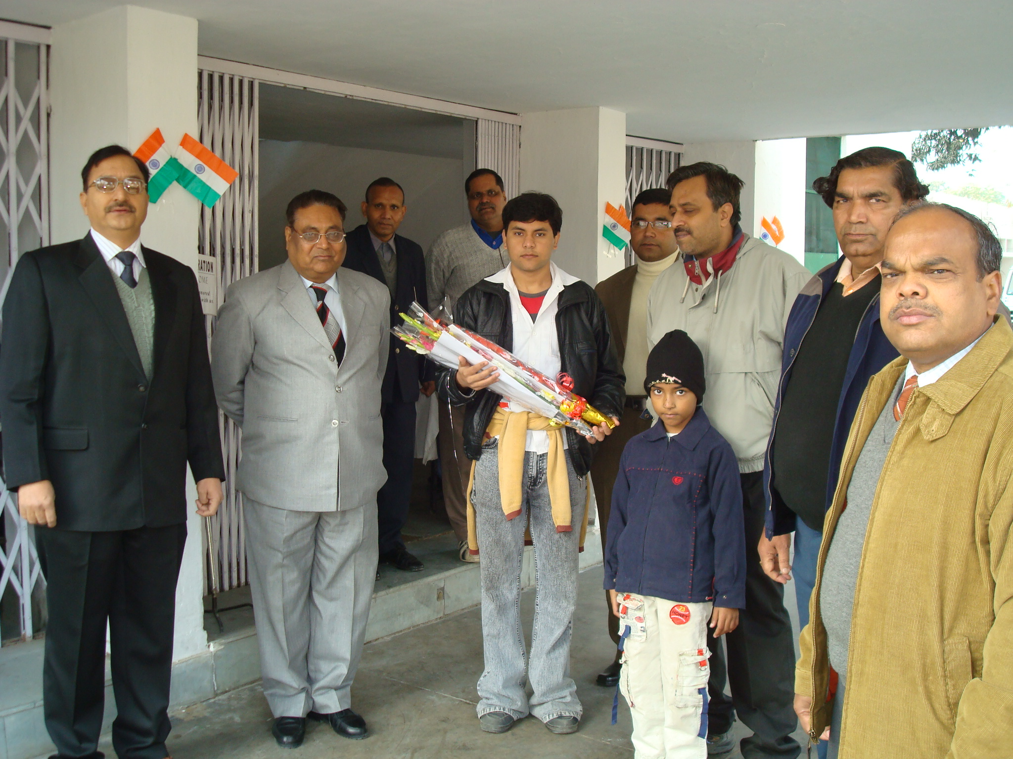

Slide 9
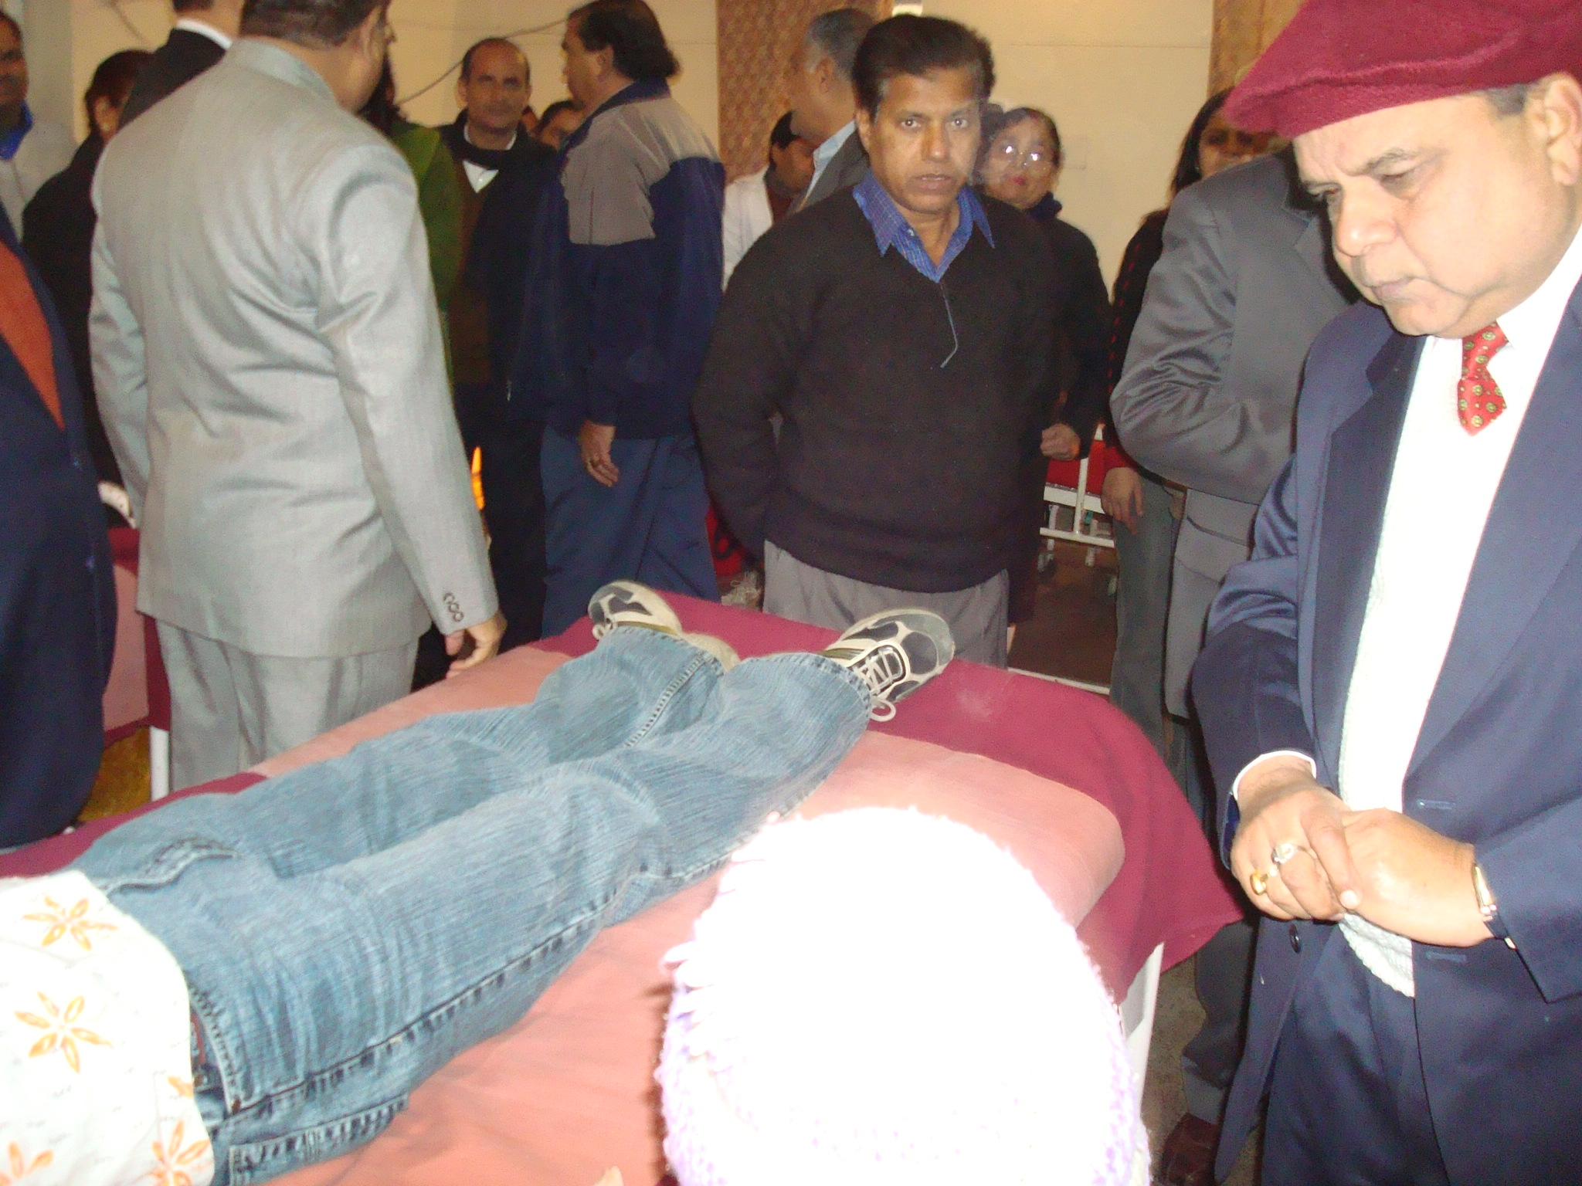

Slide 10
Health and Environment Cell Future Plans
First Aid Awareness Workshop in association with the IITR Hospital
WARP – Warm care for Aged and Retired Professors

Slide 11
Disha
Ashish Kumar

Slide 12
Disha
Aim: To work for the upliftment of the rural section of the society and to improve the living conditions of the villagers of India.
Activities this year
Evening classes for students of Khanjarpur village during the autumn semester
ASER – Annual Status of Education Report
Conducted in association with ‘Pratham’

Slide 13
Disha ASER
Two phase survey
Phase 1:
Evaluation of schools, their facilities and infrastructure
Phase 2:
Comparison of the efficacy of government and private educational institutions
Evaluation of reading, writing and understanding capabilities

Slide 14
Disha ASER – Outcome
There is a significant gap between students educated from private and government institutions
There are exceptions
Provided a clear picture and demarcated regions of thrust
Recognition: Invitation to the release function at New Delhi
Chief Guest: Mr. Montek Singh Ahluwalia, Dy. Chairman, Planning Commission

Slide 15
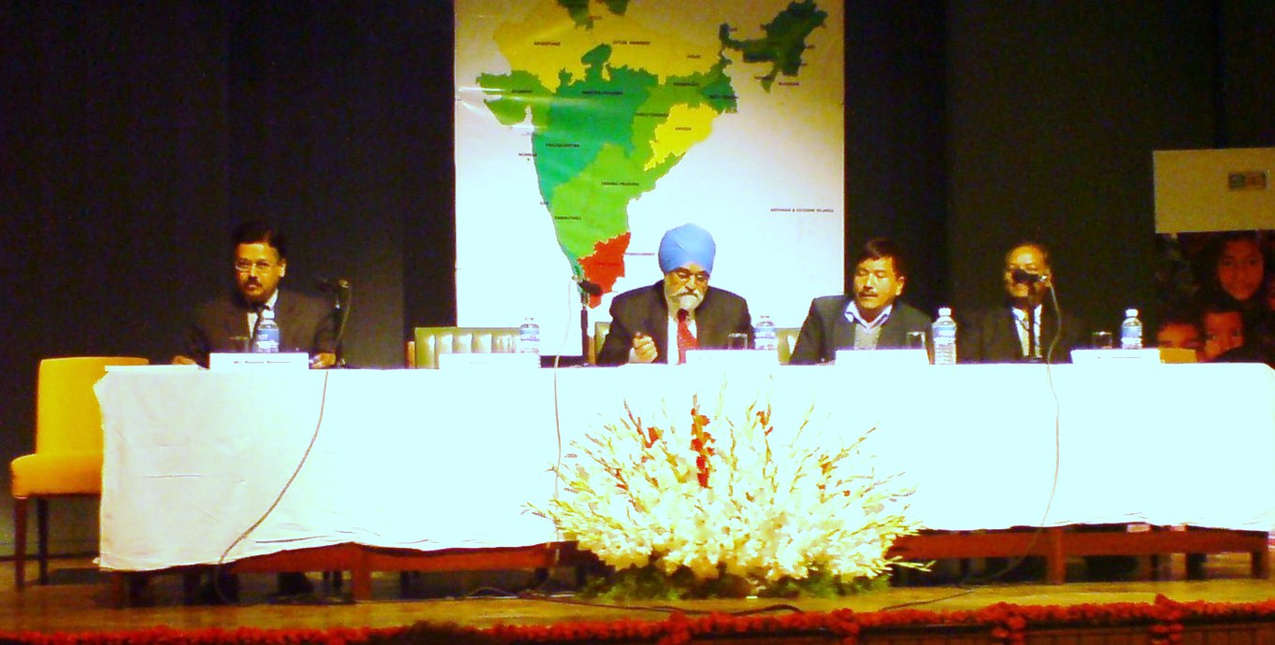
Mr Montek Singh Ahluwalia
Dy. Chairman, Planning Commission
ASER release function, New Delhi

Slide 16
Disha Future Plans
Expansion to more villages
Continued association with Pratham for rural welfare

Slide 17
Human Welfare Cell
Kartik Sharma

Slide 18
Human Welfare Cell
Key responsibility areas:
General Welfare Activities
Group Discussions
Guest Lectures

Slide 19
Human Welfare Cell Activities of this year
IPR Lecture – Dr. Babita Sinha
Panel Discussion – Collaborative linkages between Industry, Academia and the Govt.
Dr. Nangia, Prof. Alok Mishra, Dr. Sri Chand, Mr. P. K. Ghosh, Prof. G. J. Chakrapani
Lecture Series
Swami Vimalananda: Harmony in Relationships
Guest Lecture in association with Dept. of Biotech
Mr. B. L. Chawla: father of Late Kalpana Chawla

Slide 20
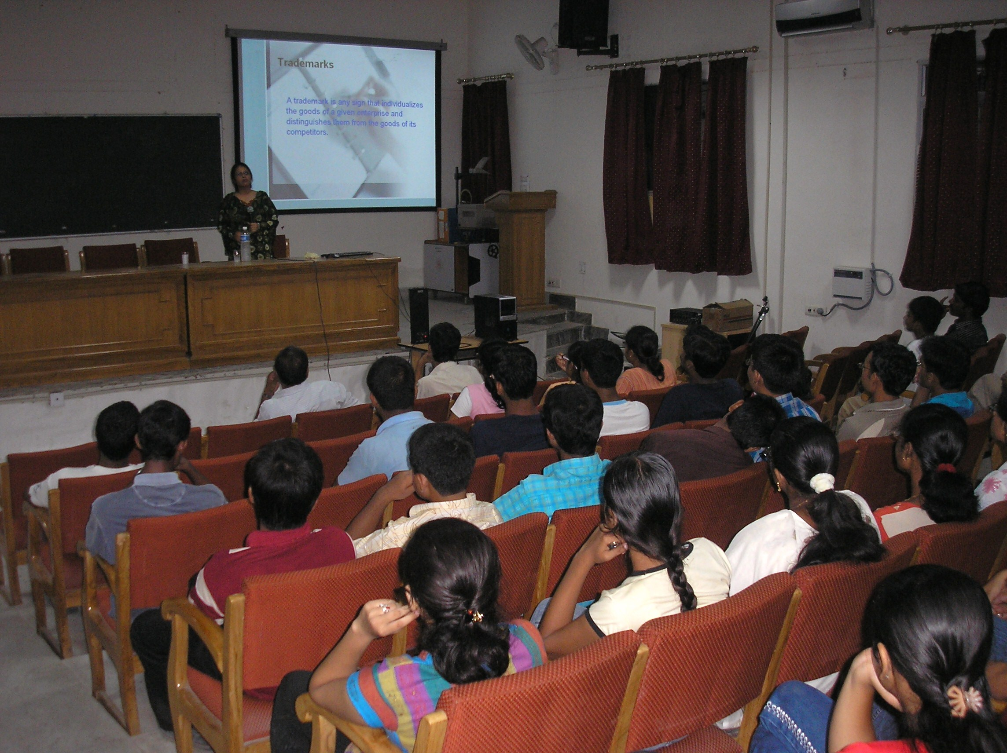

Slide 21
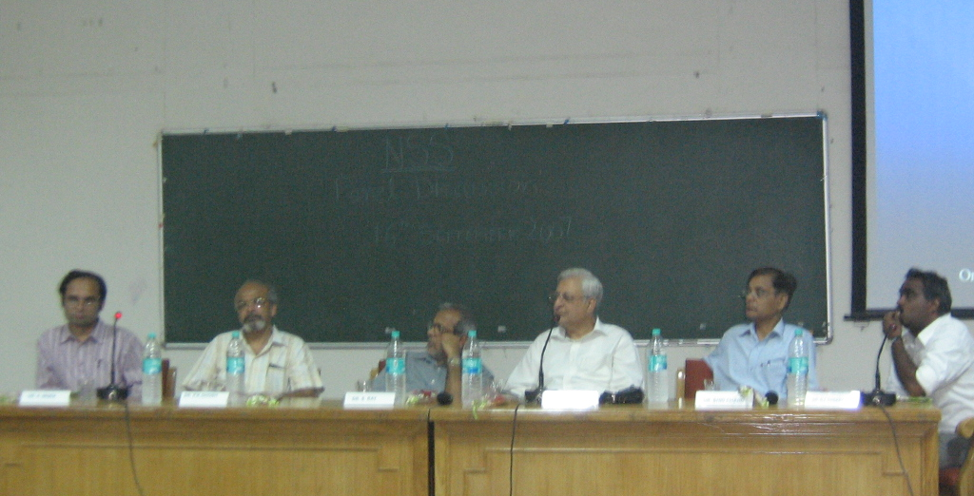
Panel Discussion

Slide 22
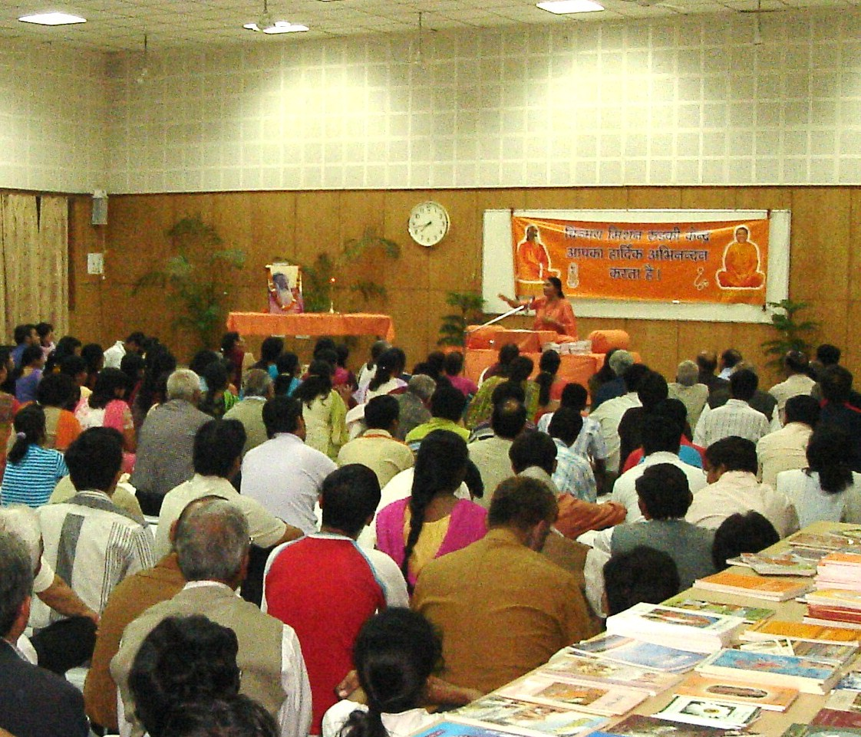

Slide 23
Social Awareness Cell
Aparajita Sant

Slide 24
Social Awareness Cell
Aims: To raise events of social importance in the eyes of the general public and make them aware of the consequences of their choices

Slide 25
Social Awareness Cell Activities
Anti Drinking Skit
Problems addressed:
Household violence
Premature disease/death
Excessive debt
Guest of Honour: Dr. Kural – CMO, IITR Hospital
Open Debate Challenge
3 stage contest
Objective: To bring out points on current and relevant issues and to improve communication and public speaking skills of all NSS volunteers.
Guest of Honour: Dr. Nagendra Kumar

Slide 26
Research and Development Cell
Ch. Venkat Aditya

Slide 27
Research and Development Cell
Aim: To incubate and implement innovative projects that help improve the activities and approach of NSS, IITR towards addressing social causes.

Slide 28
Research and Development Cell Projects Undertaken
Pickle making and Sweet Packaging
Proper market survey
Proper training at Professional Training Centers
Initial funds and raw materials
Cleanroom design based hostel room
Students of Civil and Architecture department
Guided by Prof. V. K. Katiyar
An optimal design for a dust resistant, temperature controlled room
Preheating for Maximal Efficiency of Steel rolling
Students of the Department of Material Science and Metallurgical Engineering
Mathematical modeling for efficiency determination
Optimal temperature control
Others
Bio-composite manure: Department of Chemical Engineering
Mobile phone radiation control: Department of Electronics and Computer Engineering

Slide 29
Prerna Cell
Naga Maddiletty Reddy Aakanksha Singhal

Slide 30
Prerna Cell Activities this year
From 30 to 130 – the success story
Villages covered: Khanjarpur, Bhangeri, Teliwala etc.
Teaching the relocated: children of construction workers
About 25 children
Retaining Childhood: Kaliyar
200 migrated/relocated families
Association with ‘Pratham’
65 children – 4 to 6 pm

Slide 31
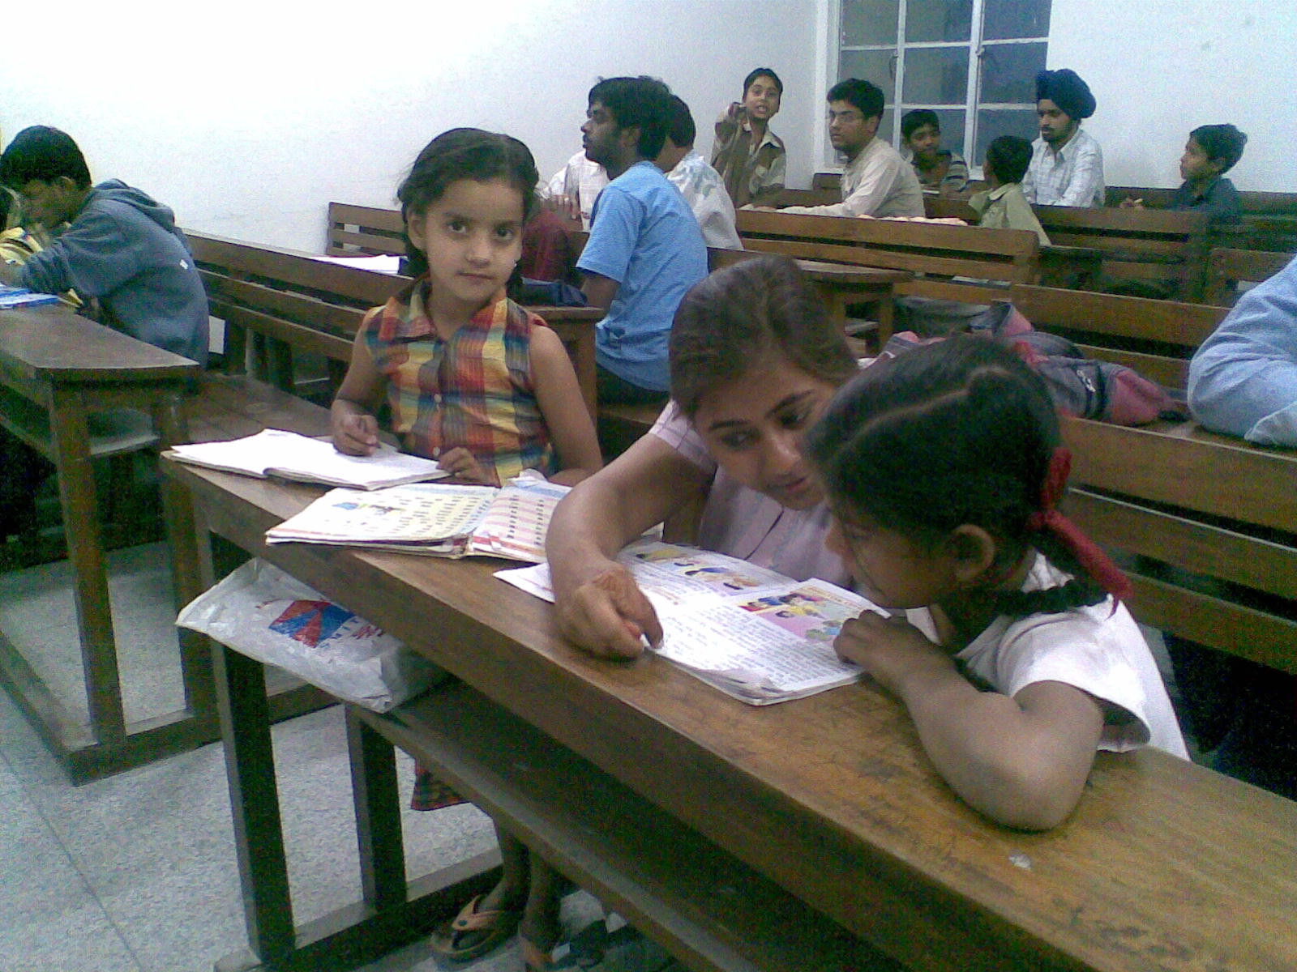

Slide 32
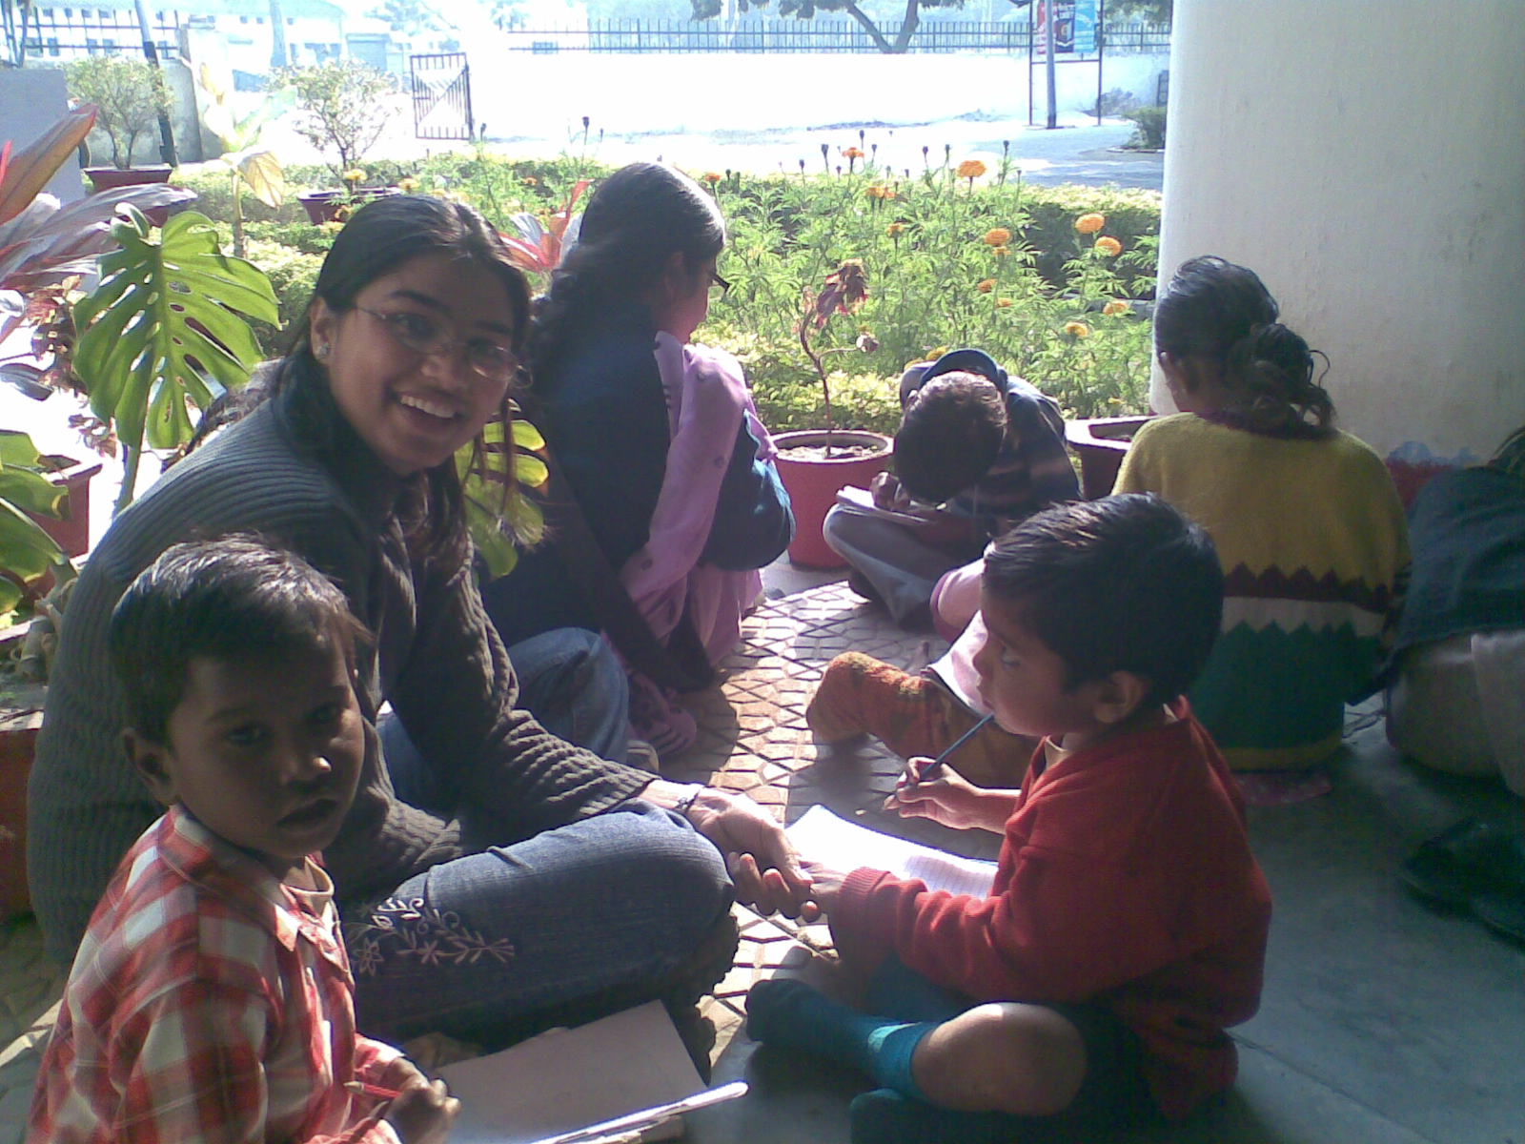

Slide 33
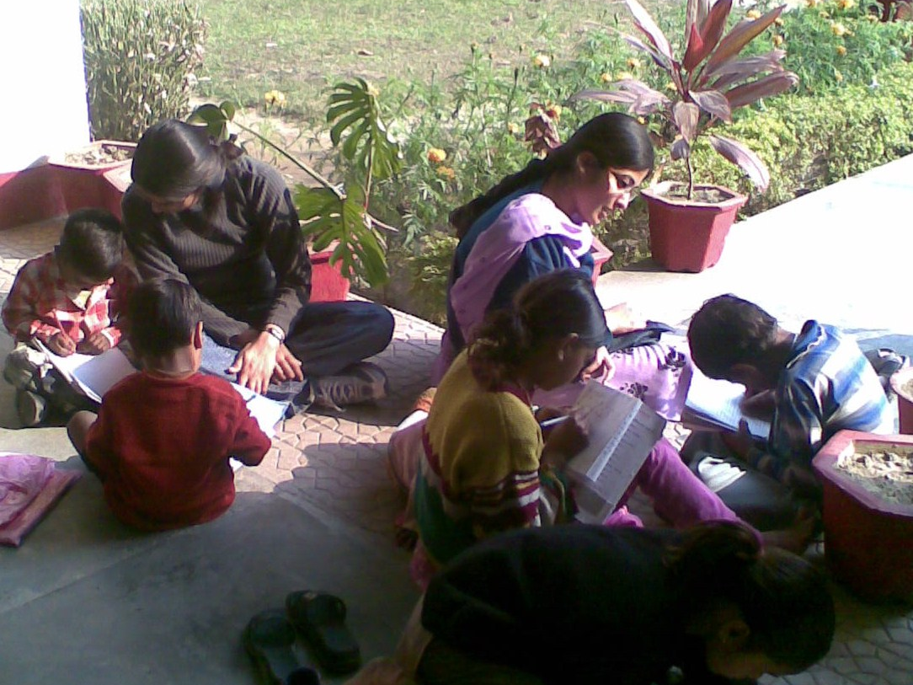

Slide 34
Prerna Cell Future Plans
Greater Organization:
Creation of Batches
Providing individual attention by assigning students to fixed batches
Weekends – Play trips
Examinations
Continue teaching wards of construction workers
Kaliyar – Motivation towards education
300 children
Similar activities in Mangalore and Haridwar

Slide 35
Conclusion
NSS is one of the most active student bodies on the IITR campus
It makes a measurable difference in the lives of hundreds of families
It is a lighthouse that guides the government towards areas that need greater attention
It is a leader in social upliftment of the areas in and around Roorkee

Slide 36
Thank You

